Slide 1
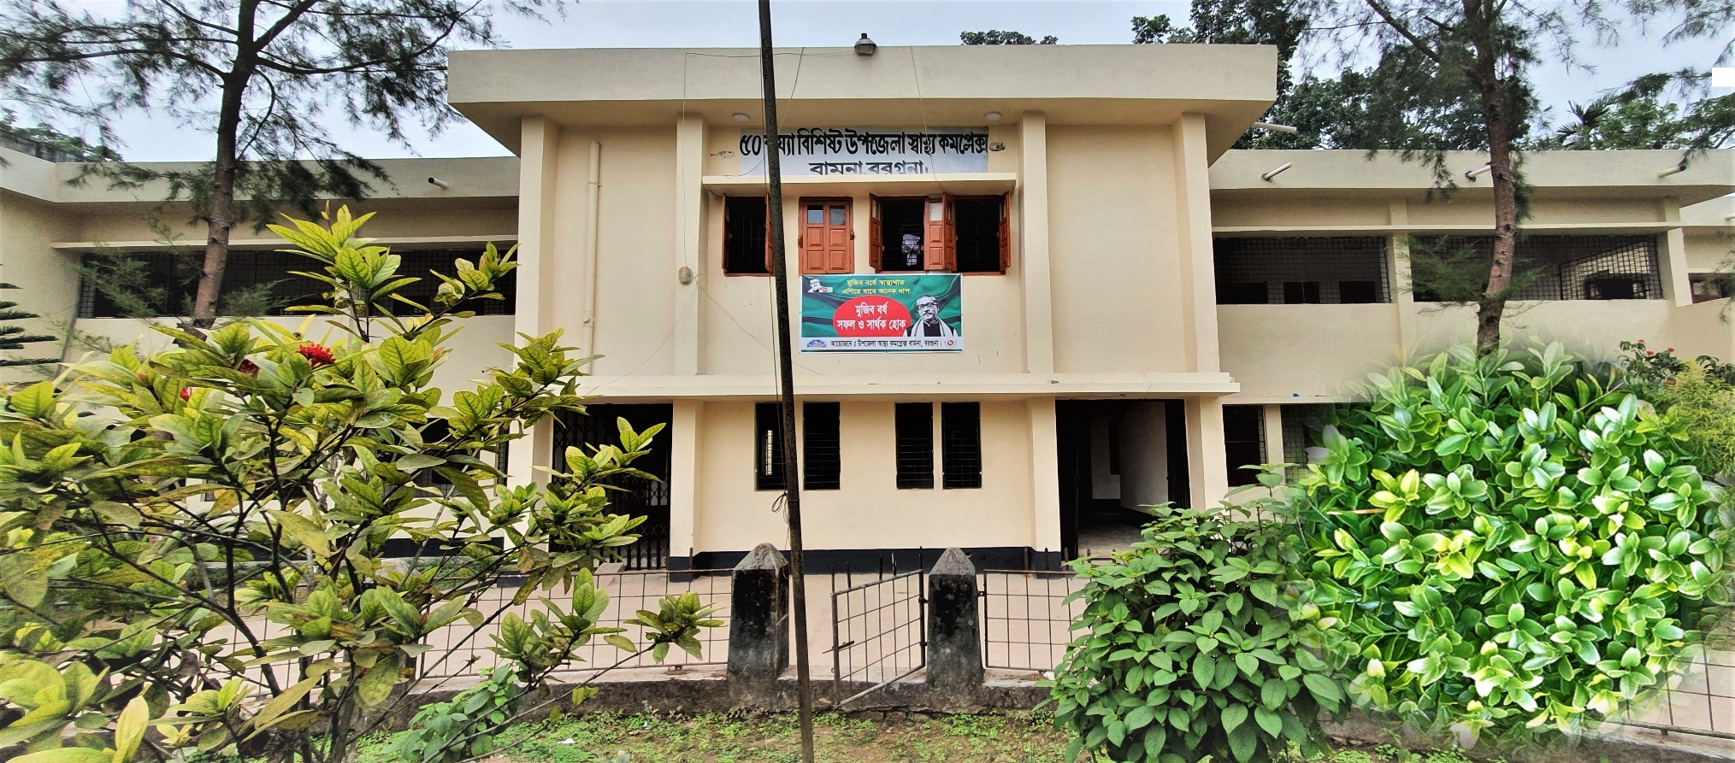
50 BEDED UPAZILA HEALTH COMPLEX
Bamna, Barguna.

Slide 2
A Sub-district level Hospital with a Vision
Maximum utilization of Govt.
resources with
honesty and sincerity
Integrated approach of
Administration, Community
Leaders & Health
Management
Providing Effective and
prompt services
through improved
management system

Slide 3
Background History of Bamna Upazilla Health Complex, Barguna
To reduce Maternal and Child Mortality and Mobility and to ensure the quality services to the mother and child, UHFPO opened special activities in 2012.
Special activities:
ANC-Corner
Basic EOC service
IMCI corner for under 5 children
Regular VIA Test
Others Special activities:
*Adolescents Friendly Health Corner,
* ORT Corner
*NCD corner,

Slide 4
Contd.
The UHC started as 31 bedded hospital in
Hospital is upgraded to 50 bedded hospital by Honorable Prime Minister Sheikh Hasina in 2012.
Form 2014 started Comprehensive EOC program.
NCD Corner started in 2019.
From 2020 Safe Blood Transfusion unit established in Bamna hospital
SSK program started in July 2022.

Slide 5
Health Profile of Bamna Upazila- 2021
Total population : 94036
Total Fertile Couples : 15055
Total Pregnant : 2176
Total Delivery : 1718
Total Live birth : 1715
Total death : 268
Total Maternal death : 02
Health Man power
a. Doctor : 12 ( 6 + 6)
b. Nurse : 24
c. HA : 22
d. CHCP : 8 .
e. Volunteer, Security guard & cleaner: 06
9. Health Institutions
a. Health Complex : 01
b. H & FWC : 03 ( FWC– 3 )
c. Community clinic : 09
d. Non- Govt. Clinic : 05

Slide 6
10. Mother Taken-ANC : 95% ( 1st Visit)
11. Hospital Delivery Rate : 45%
12. No. of Hospital bed : 50
13. Bed Occupancy Rate : 83%
14.CPR
15.TFR
16.EPI Coverage.
17.TB Case detection rate.
18.IMR
19.NMR
20.Under 5 MR.
21.MMR

Slide 7

Bamna UHC
Bed Occupancy Rate from 2017 to 2021

Slide 8
Emergency , Out Door, Indoor Service 2017 to 2022
Bamna UHC

Slide 9
Bamna UHC
EOC Activities : 2017 to July 2022 (NVD and C-section)
Please add data of Bamna UHC

Slide 10
Bamna UHC
ANC Care: 2017 to July 2022 (ANC 1st and 4th Visit)
Please add data of Bamna UHC

Slide 11
Bamna UHC
EOC Activities : 2013- 2022 (Hospital Delivery )

Slide 12
Comparative data of revenue income (in Taka) from 2019 to 2021
BAMNA UHC

Slide 13
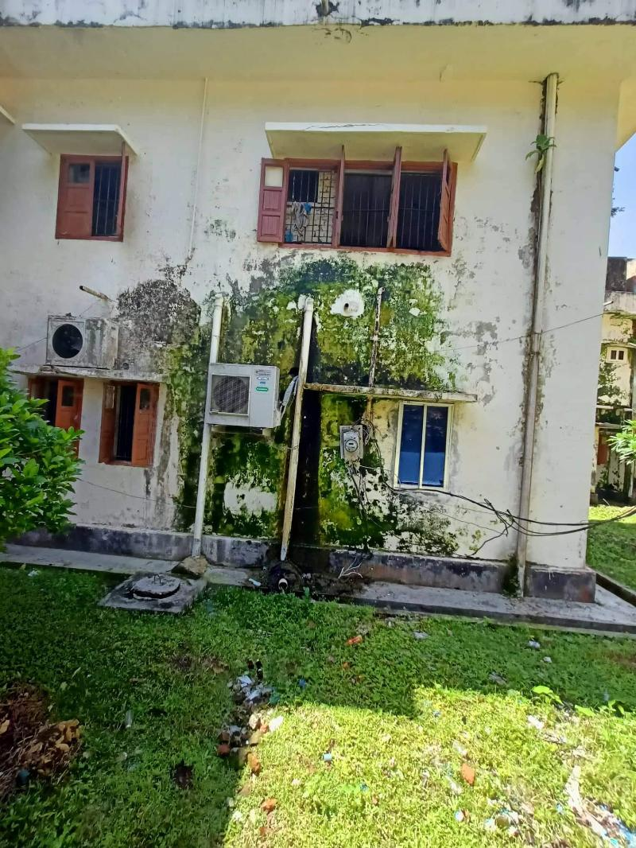
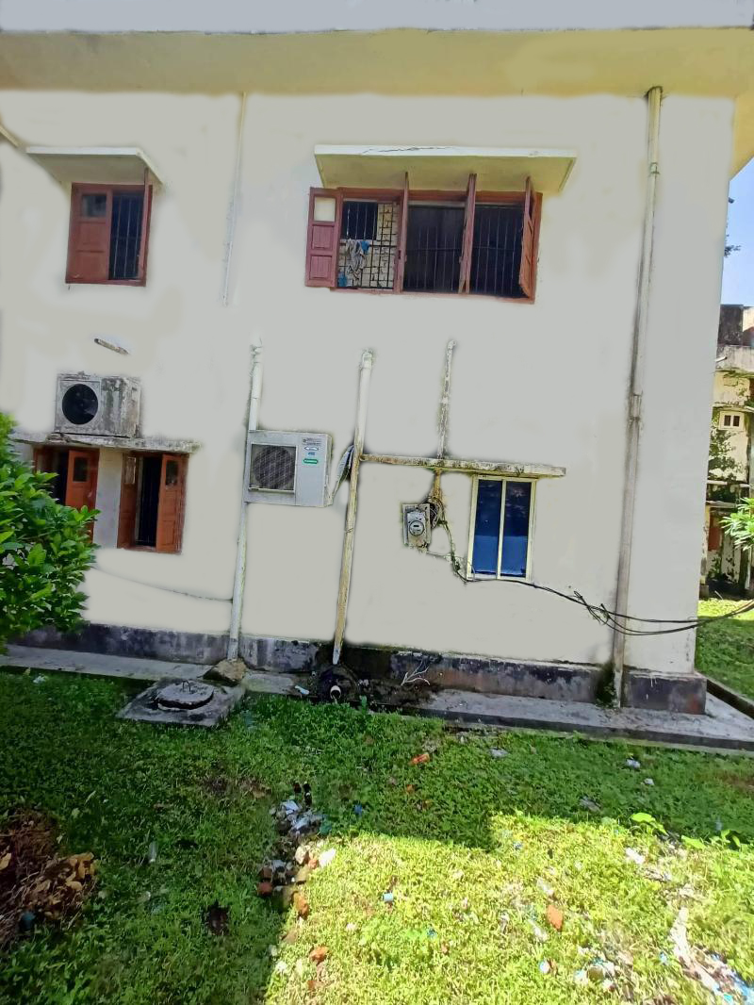
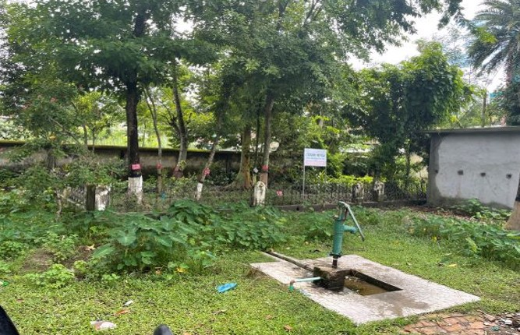
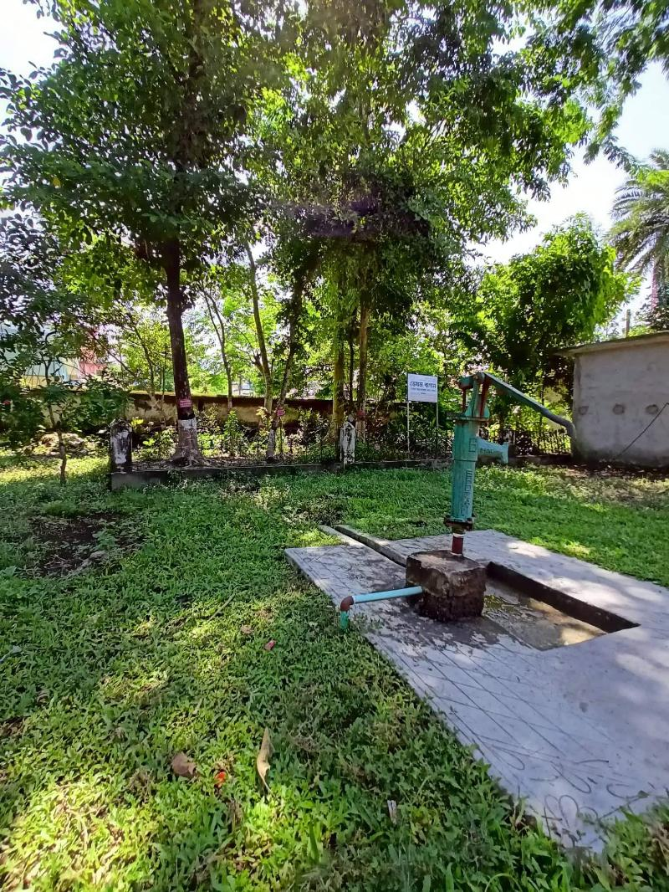
Cleaning and Beautification of building and Campus of UHC
Observational Difference between August-22 and September-22
BEFORE
AFTER
BEFORE
AFTER

Slide 14
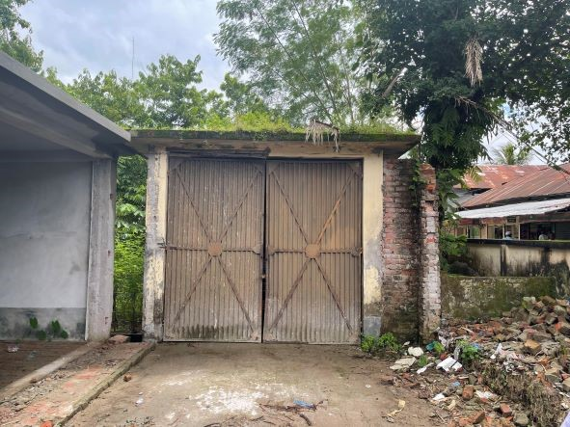
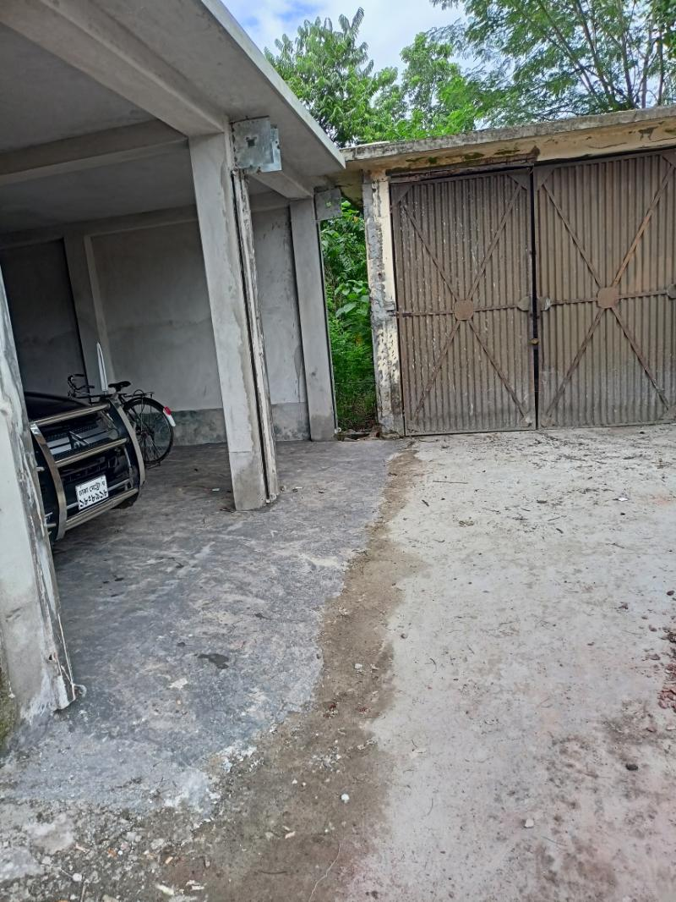
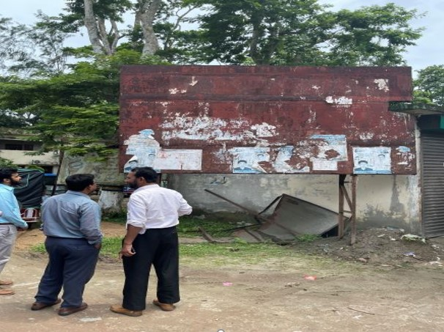
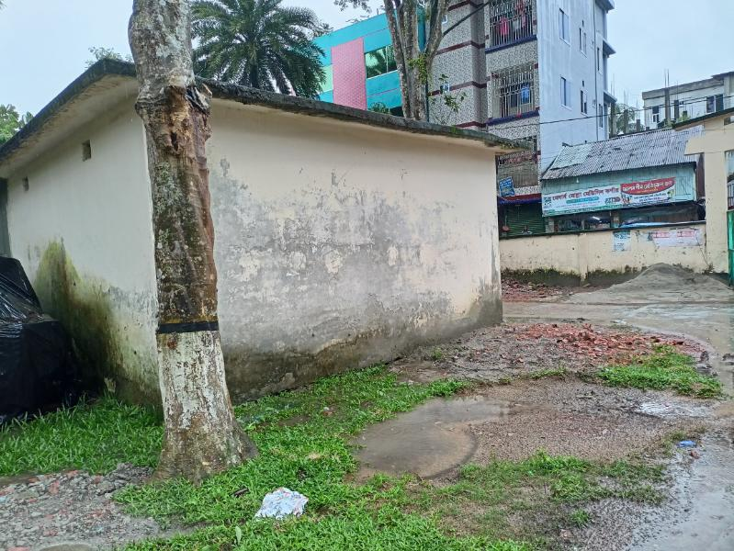
Removal of Bushes from the Roof of the Ambulance Garage and Billboard from the Campus
Observational Difference between August-22 and September-22
BEFORE
AFTER
BEFORE
AFTER

Slide 15
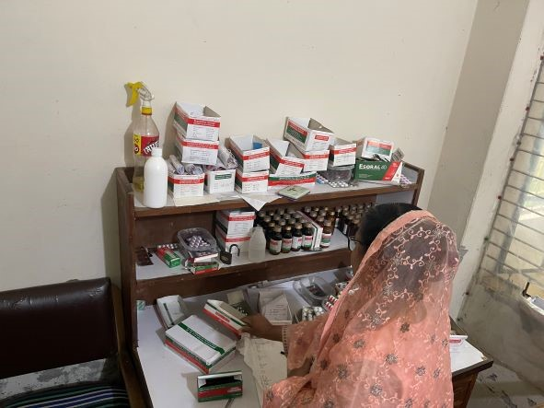
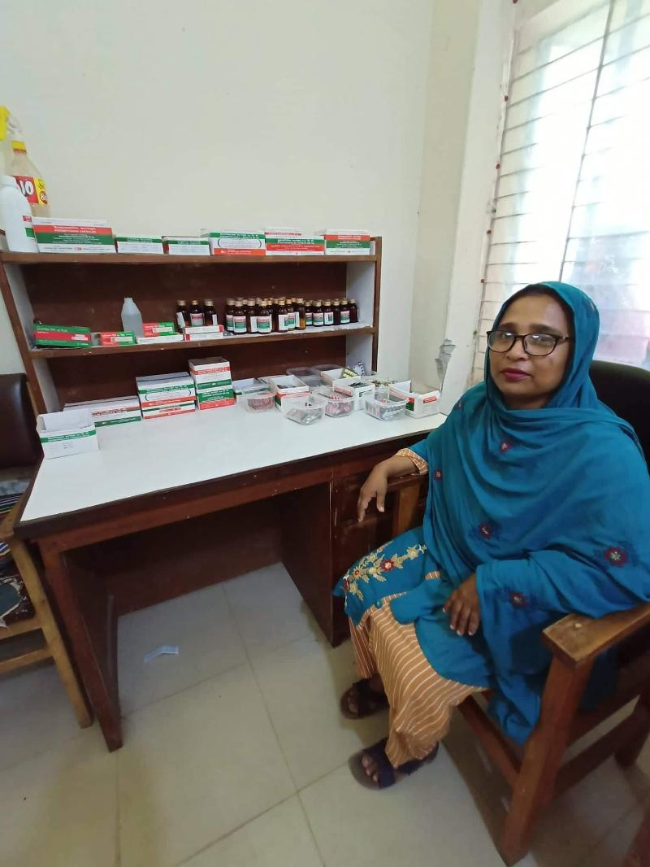
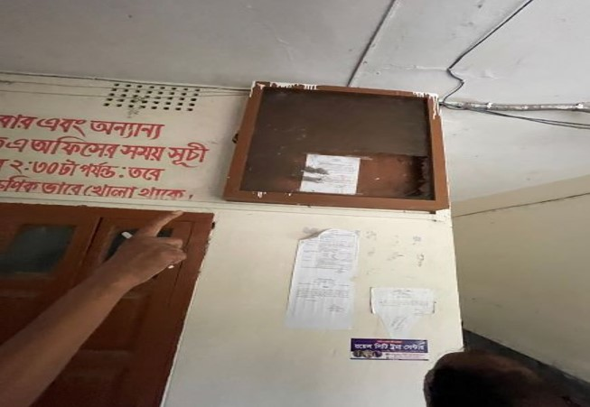
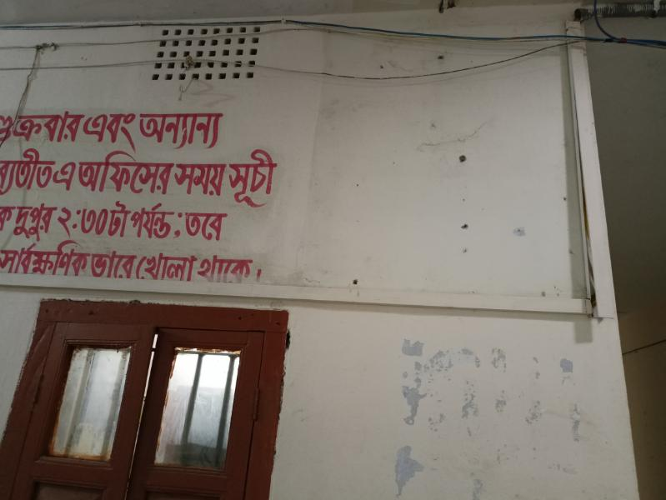
Organized Pharmacy and Removal of Non Usable Notice Board from UHC Building
Observational Difference between August-22 and September-22
BEFORE
AFTER
BEFORE
AFTER

Slide 16
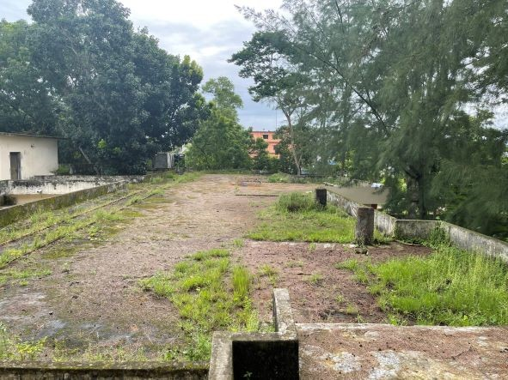
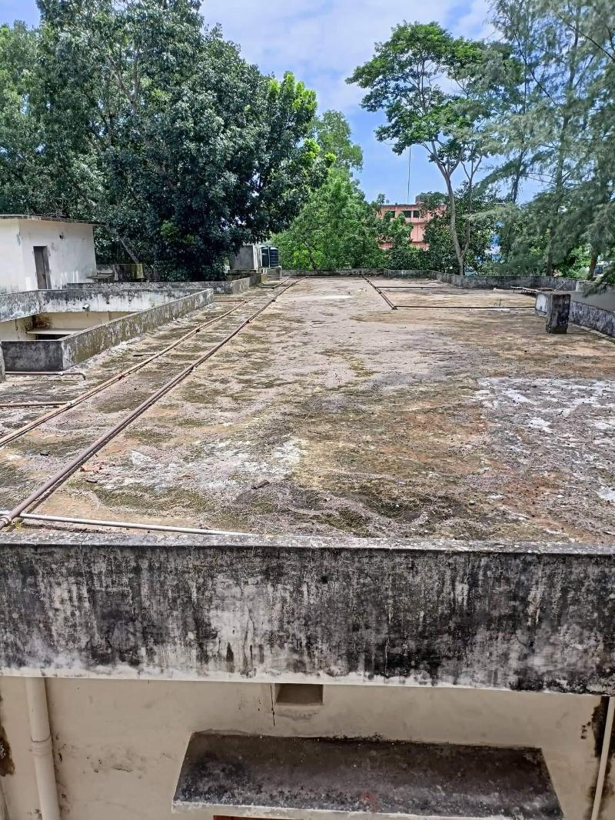
Removal of Bushes from the Roof UHC Building
Observational Difference between August-22 and September-22
BEFORE
AFTER

Slide 17
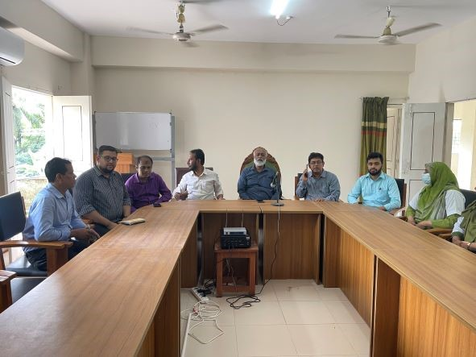
Conference Room of Bamna UHC

Slide 18
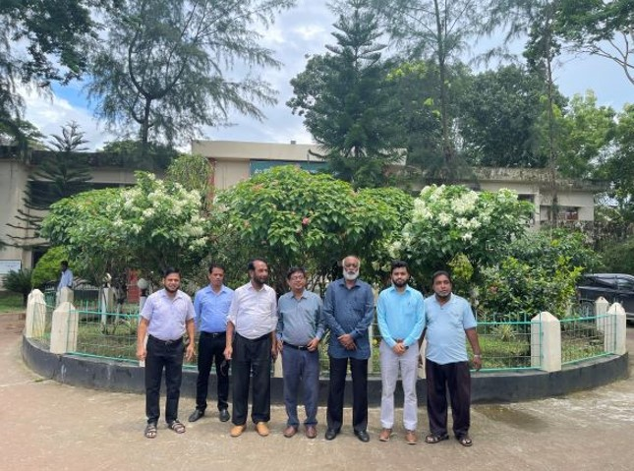
Garden in front of the UHC

Slide 19
Bamna Upazila Health Complex
Community Support
Two IPS donated by Local MP.
Dental Doctors Room was Decorated by Upazila Parishad.
X-Ray room was well established by Upazila Parishad.
Blood donated about 85 units by blood donors in emergency need.

Slide 20
Achievement of Bamna Health Complex
* In 2012, Bamna Health Complex declared as the 50
bedded in Bamna Upazilla health complex.
  Mobilized 7 additional workers from community
  (2 volunteer, 3 cleaners and others 1)
  EOC Beds 05.
  Bamna Health complex is awarded for best performance in HSS.
  COVID Achievement
  0% Mortality in Bamna Hospital
  Regular OPD Rx, Hospitalization With Proper Max in COVID Unit& Proper Referral.
  Successful COVID Vaccination (72%) in Bamna Upazila.
  Pathological Tests , ECG, X-Ray & USG is Available.

Slide 21
Challenges
Many of the post of human resource are vacant.
No store room in the Hospital
Main building of the Hospital is old and reconstruction is necessary.
The quarter of officers quarter and dormitory needs urgently reconstruction.
Post creation of human resources of 50 bedded Hospital.

Slide 22
Way Forward….
Starting of VIA activities to prevent cervical and breast cancer of female.
Starting of C-section for delivery mother.
Establishment of USG service.
Functioning of ECG service.
Implementation of effective SSK program.
Establish a cycle stand close to the main gate.

Slide 23

Thank You
Notes:
23

